Slide 1
GPROF TROPICS

Slide 2
The GPM radiometer algorithm - GPROF
Step 1: Use GPM Satellite to derive set of “Observed” profiles that define an a-priori database of possible rain structures.
Step2: Compare observed Tb to Database Tb. Select and average matching pairs
TB database profile #1
TB observed
TB database profile #2
~10 km
TB database profile #3

Slide 3
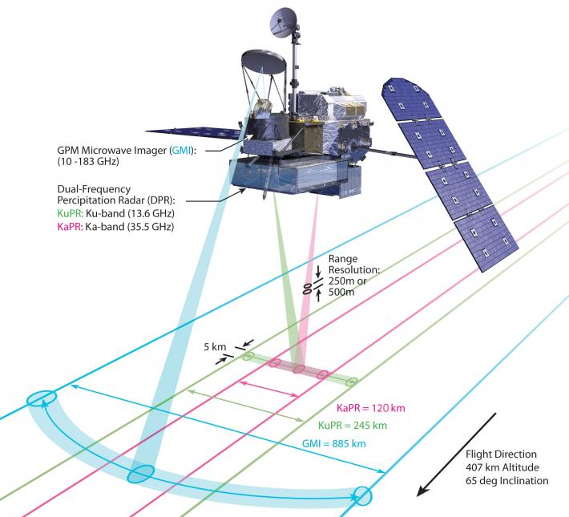
GPROF’s GPM Core Observatory Database
DPR rain rates (near nadir)
GPM Microwave Imager (GMI) brightness temperatures
GPM Combined radar/radiometer algorithm for raining scenes
NOAA MIRS for non-raining scenes
Extra steps for snow, ice, and orographic precipitation where neither GPM or MIRS works particularly well
Image: http://pmm.nasa.gov

Slide 4
GPROF 2021 A-Priori Database Creation
Ocean, Vegetated, Coast, and Sea-Ice Surface Types
Combine the profiles and surface parameters with profiles from CMB, MIRS, SLH and ERA5, for all pixels at radar resolution
Pre- Radiative Transfer files
Tbs, Surface Rain rates,
Hydrometeor Profiles
Radiative Transfer Routine
Tb Simulator for all Constellation Sensors
GPM A-Priori Satellite Sensor Databases
GMI
AMSR2
SSMIS
SSMI, TMI, AMSRE
MHS
ATMS
New Sensors -TMS

Slide 5
GPROF TMS Database
Use GPM database to compute Tb for TMS sensor
5 TMS channels simulated for rain retrieval
  91.655 GHz
  184.41 GHz
  186.51 GHz
  190.31 GHz
  204.8 GHz
All cross-track sensor also have a small pdf adjustment to match observed and simulated Tb distributions. This offset persist despite careful intercalibration, QC effort by Xcal team. Still on “todo” list.
TMS shows this offset also

Slide 6
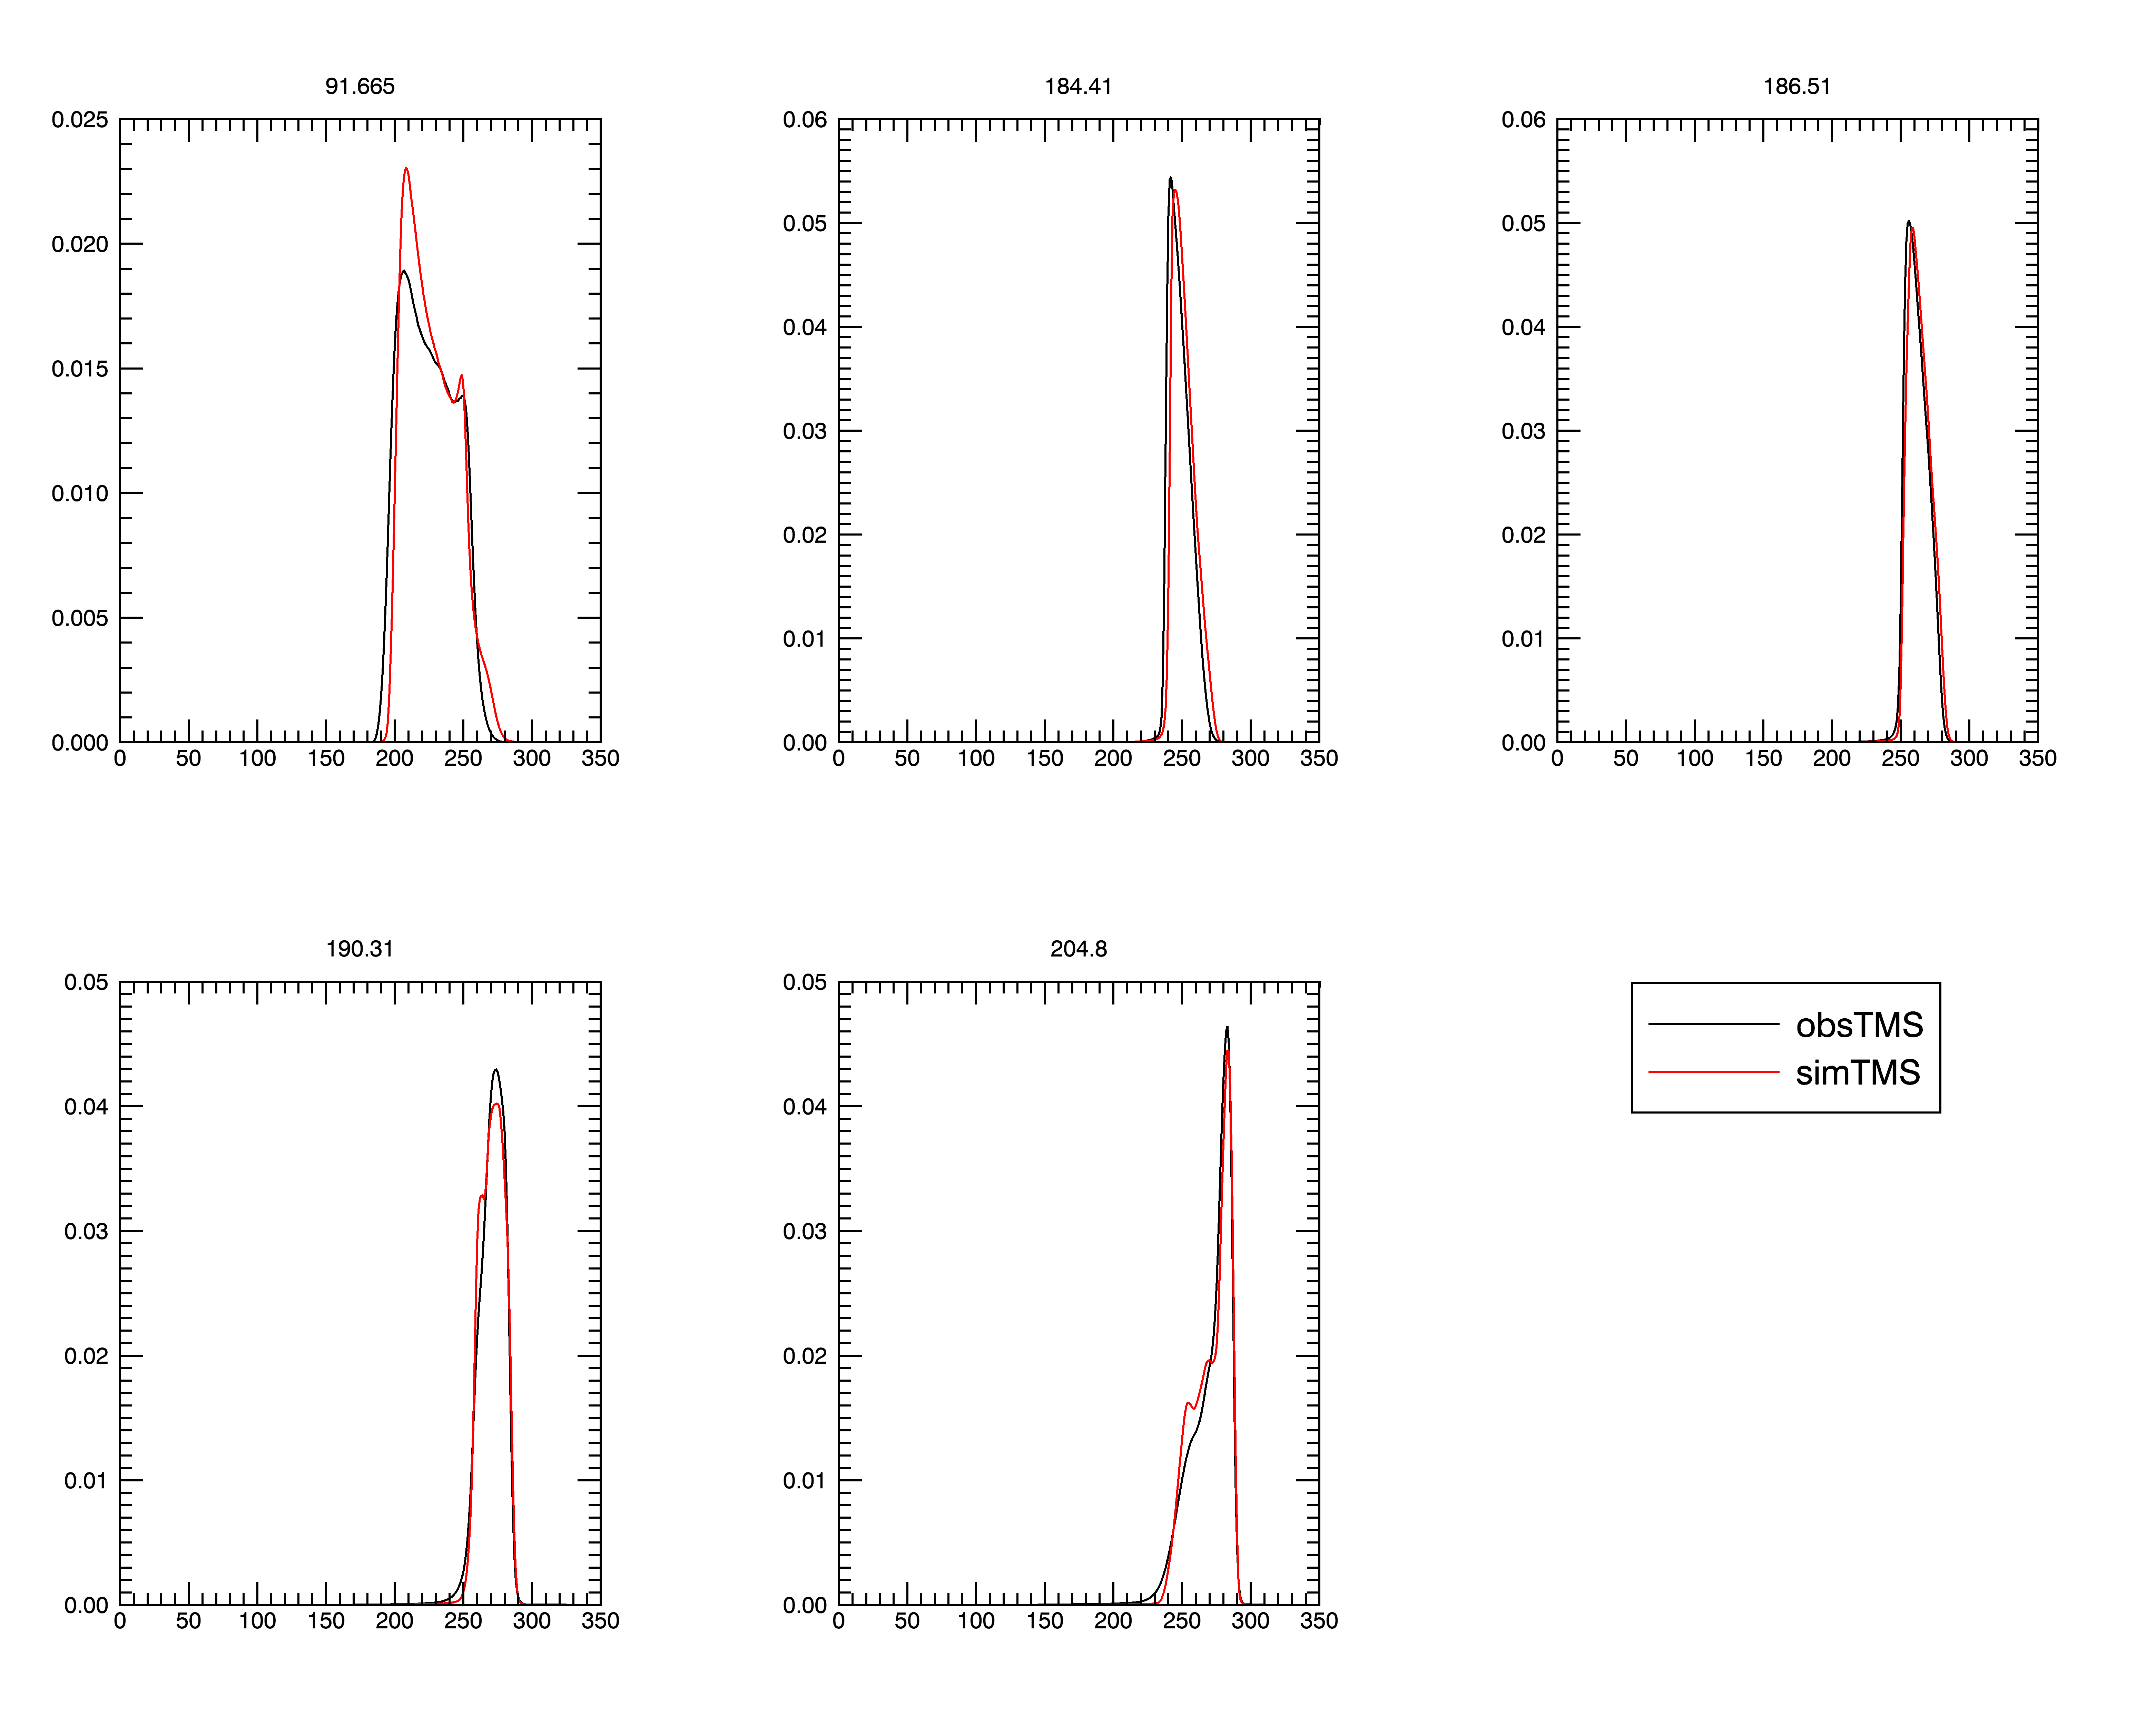
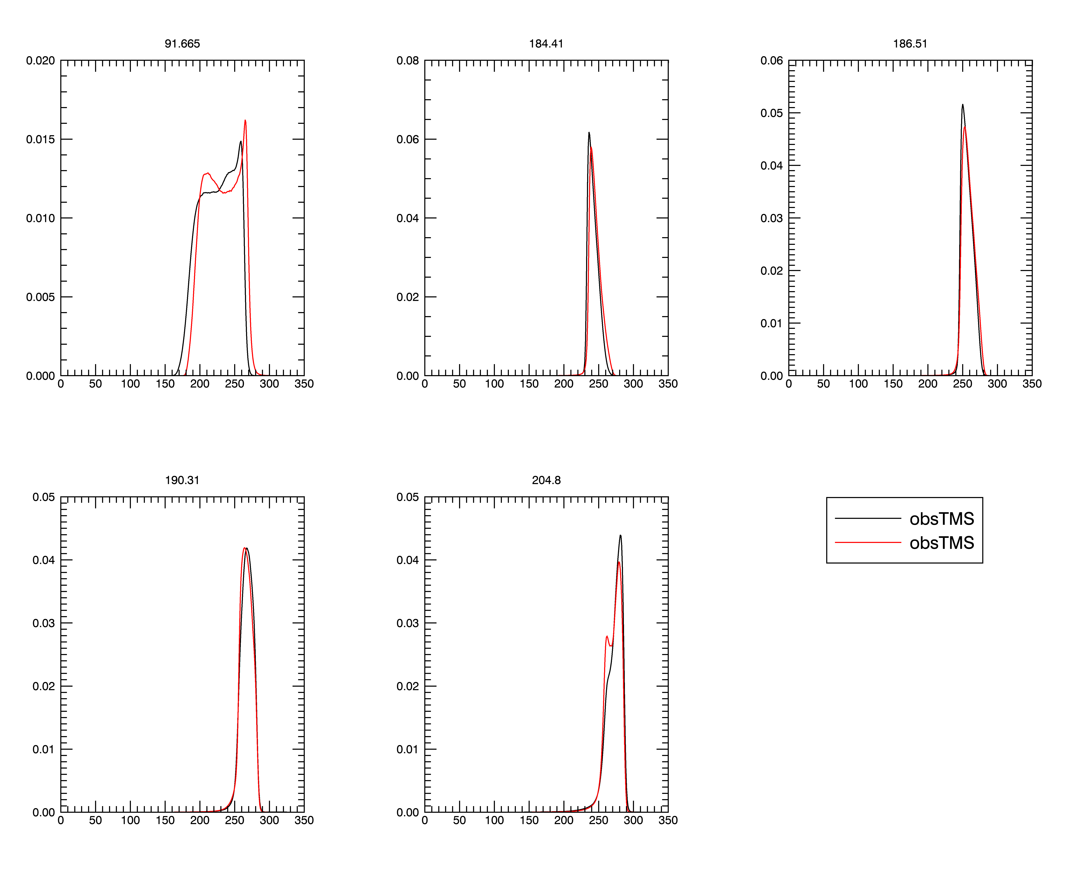
PDFs of TMS Pathfinder Observed vs Simulated Brightness temperature: Ocean
Nadir
53°
Tb (°K)
Tb (°K)

Slide 7
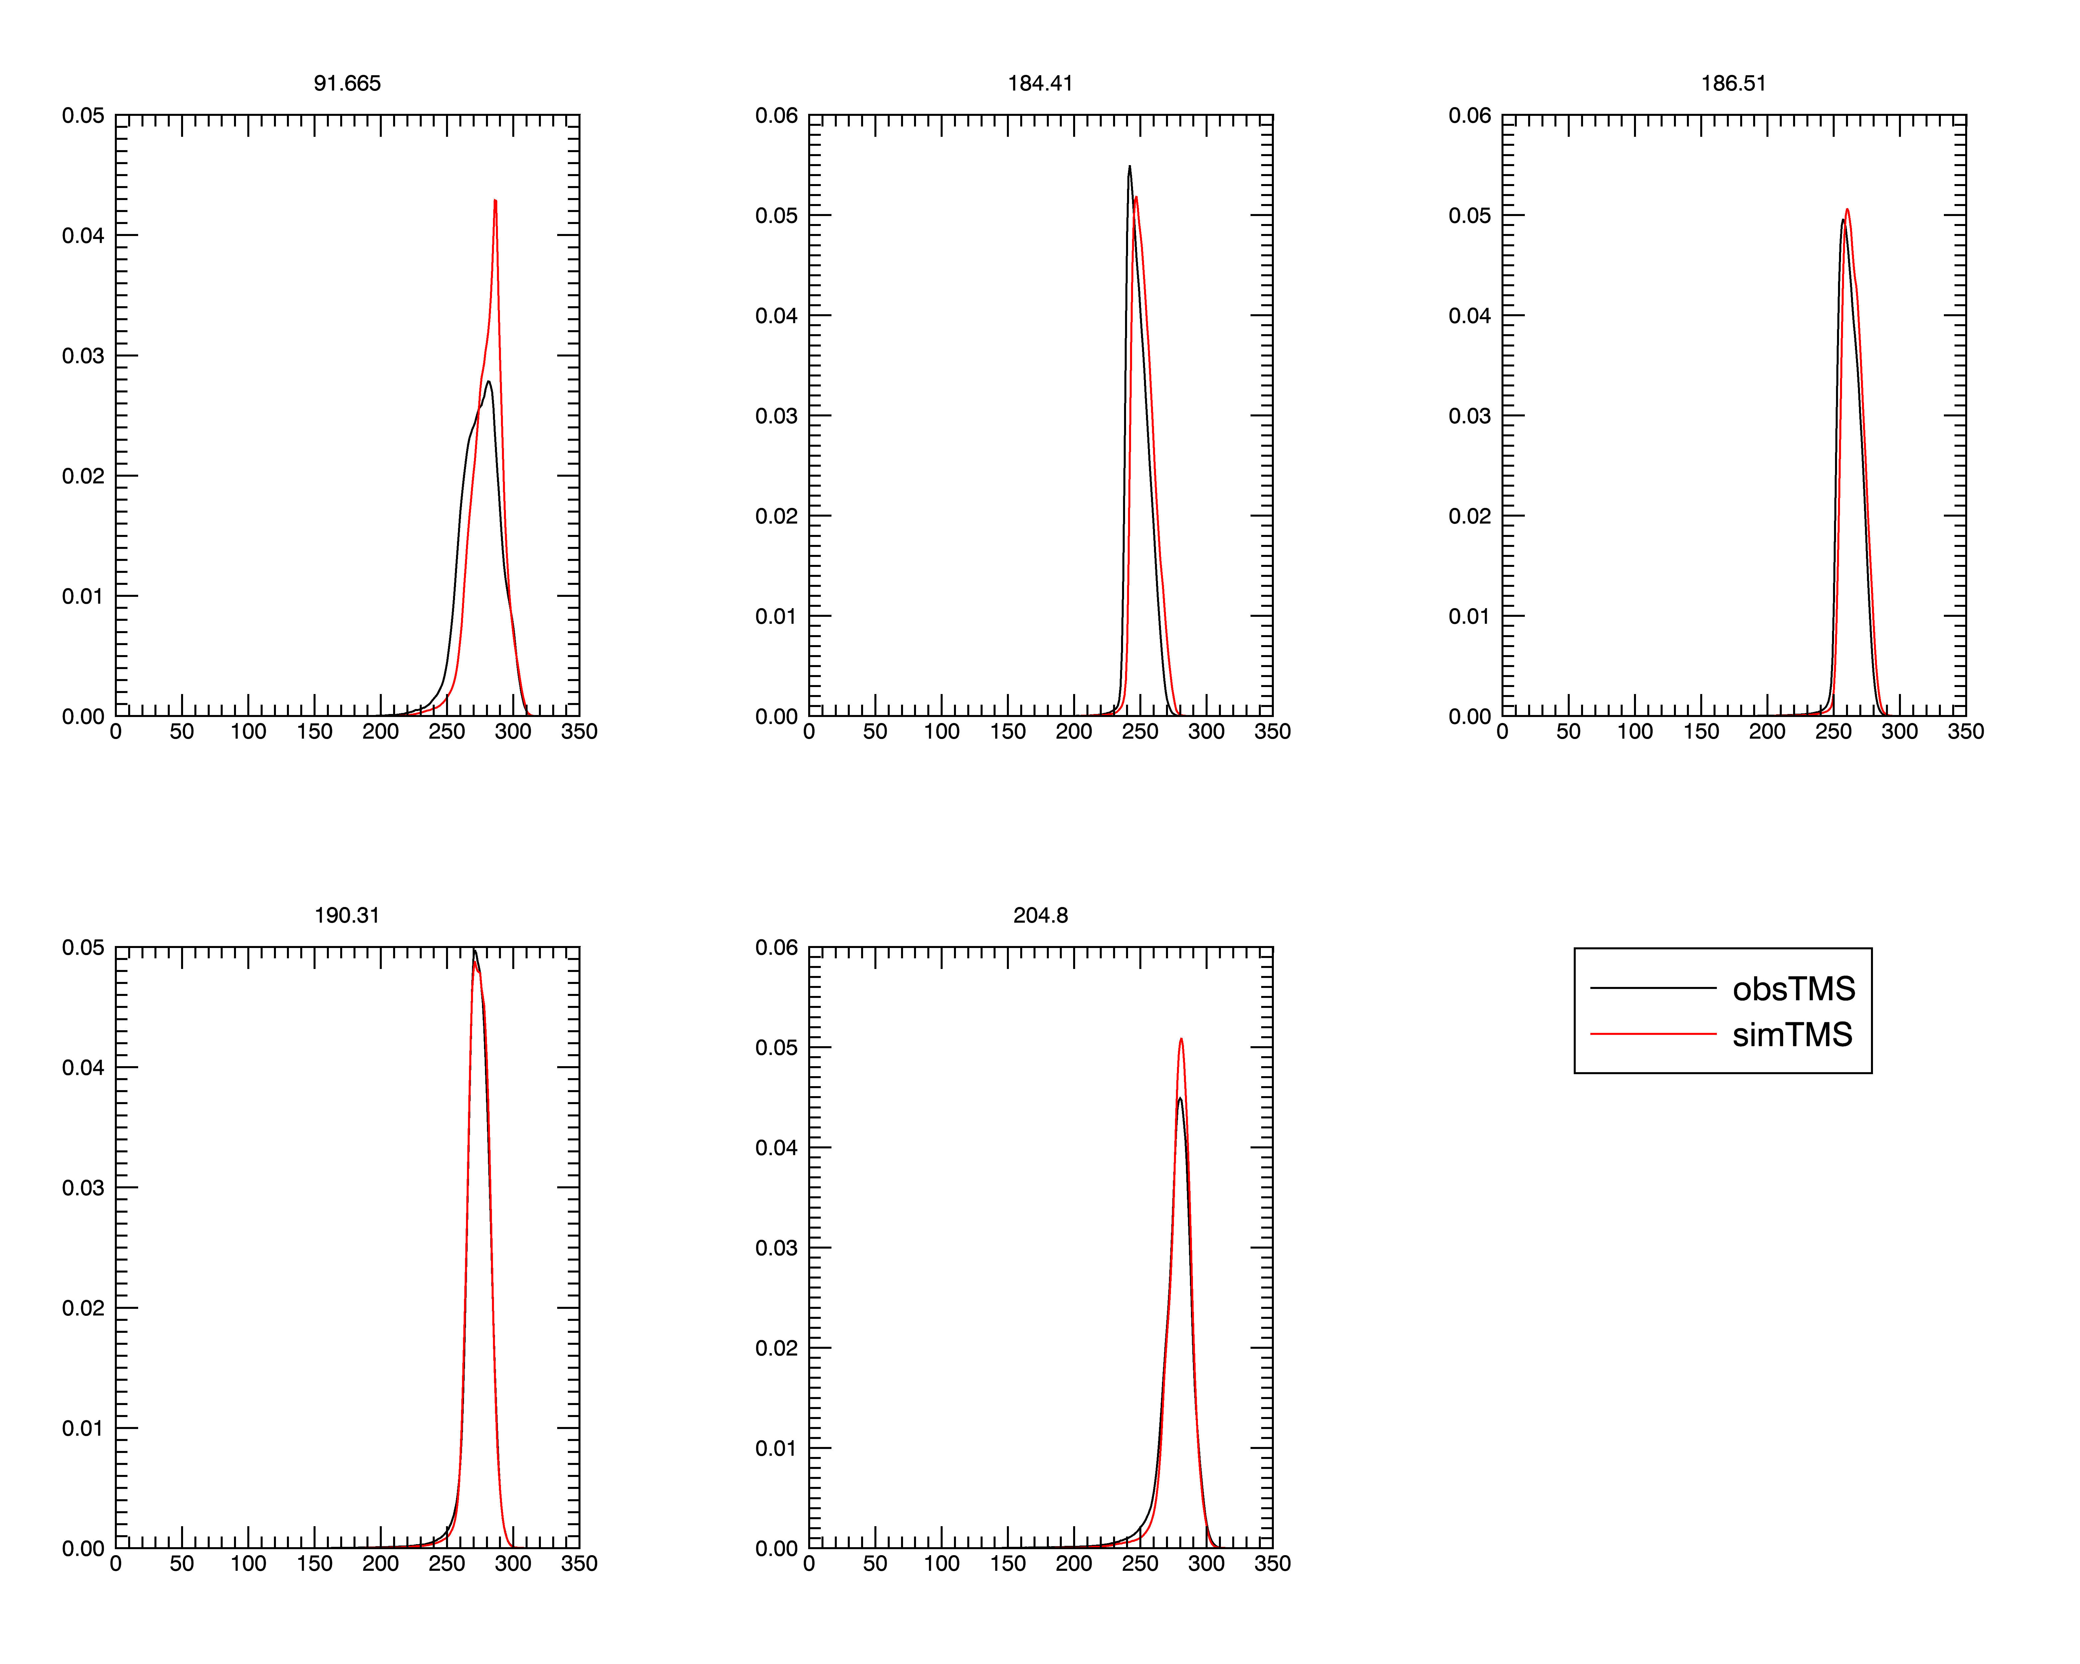
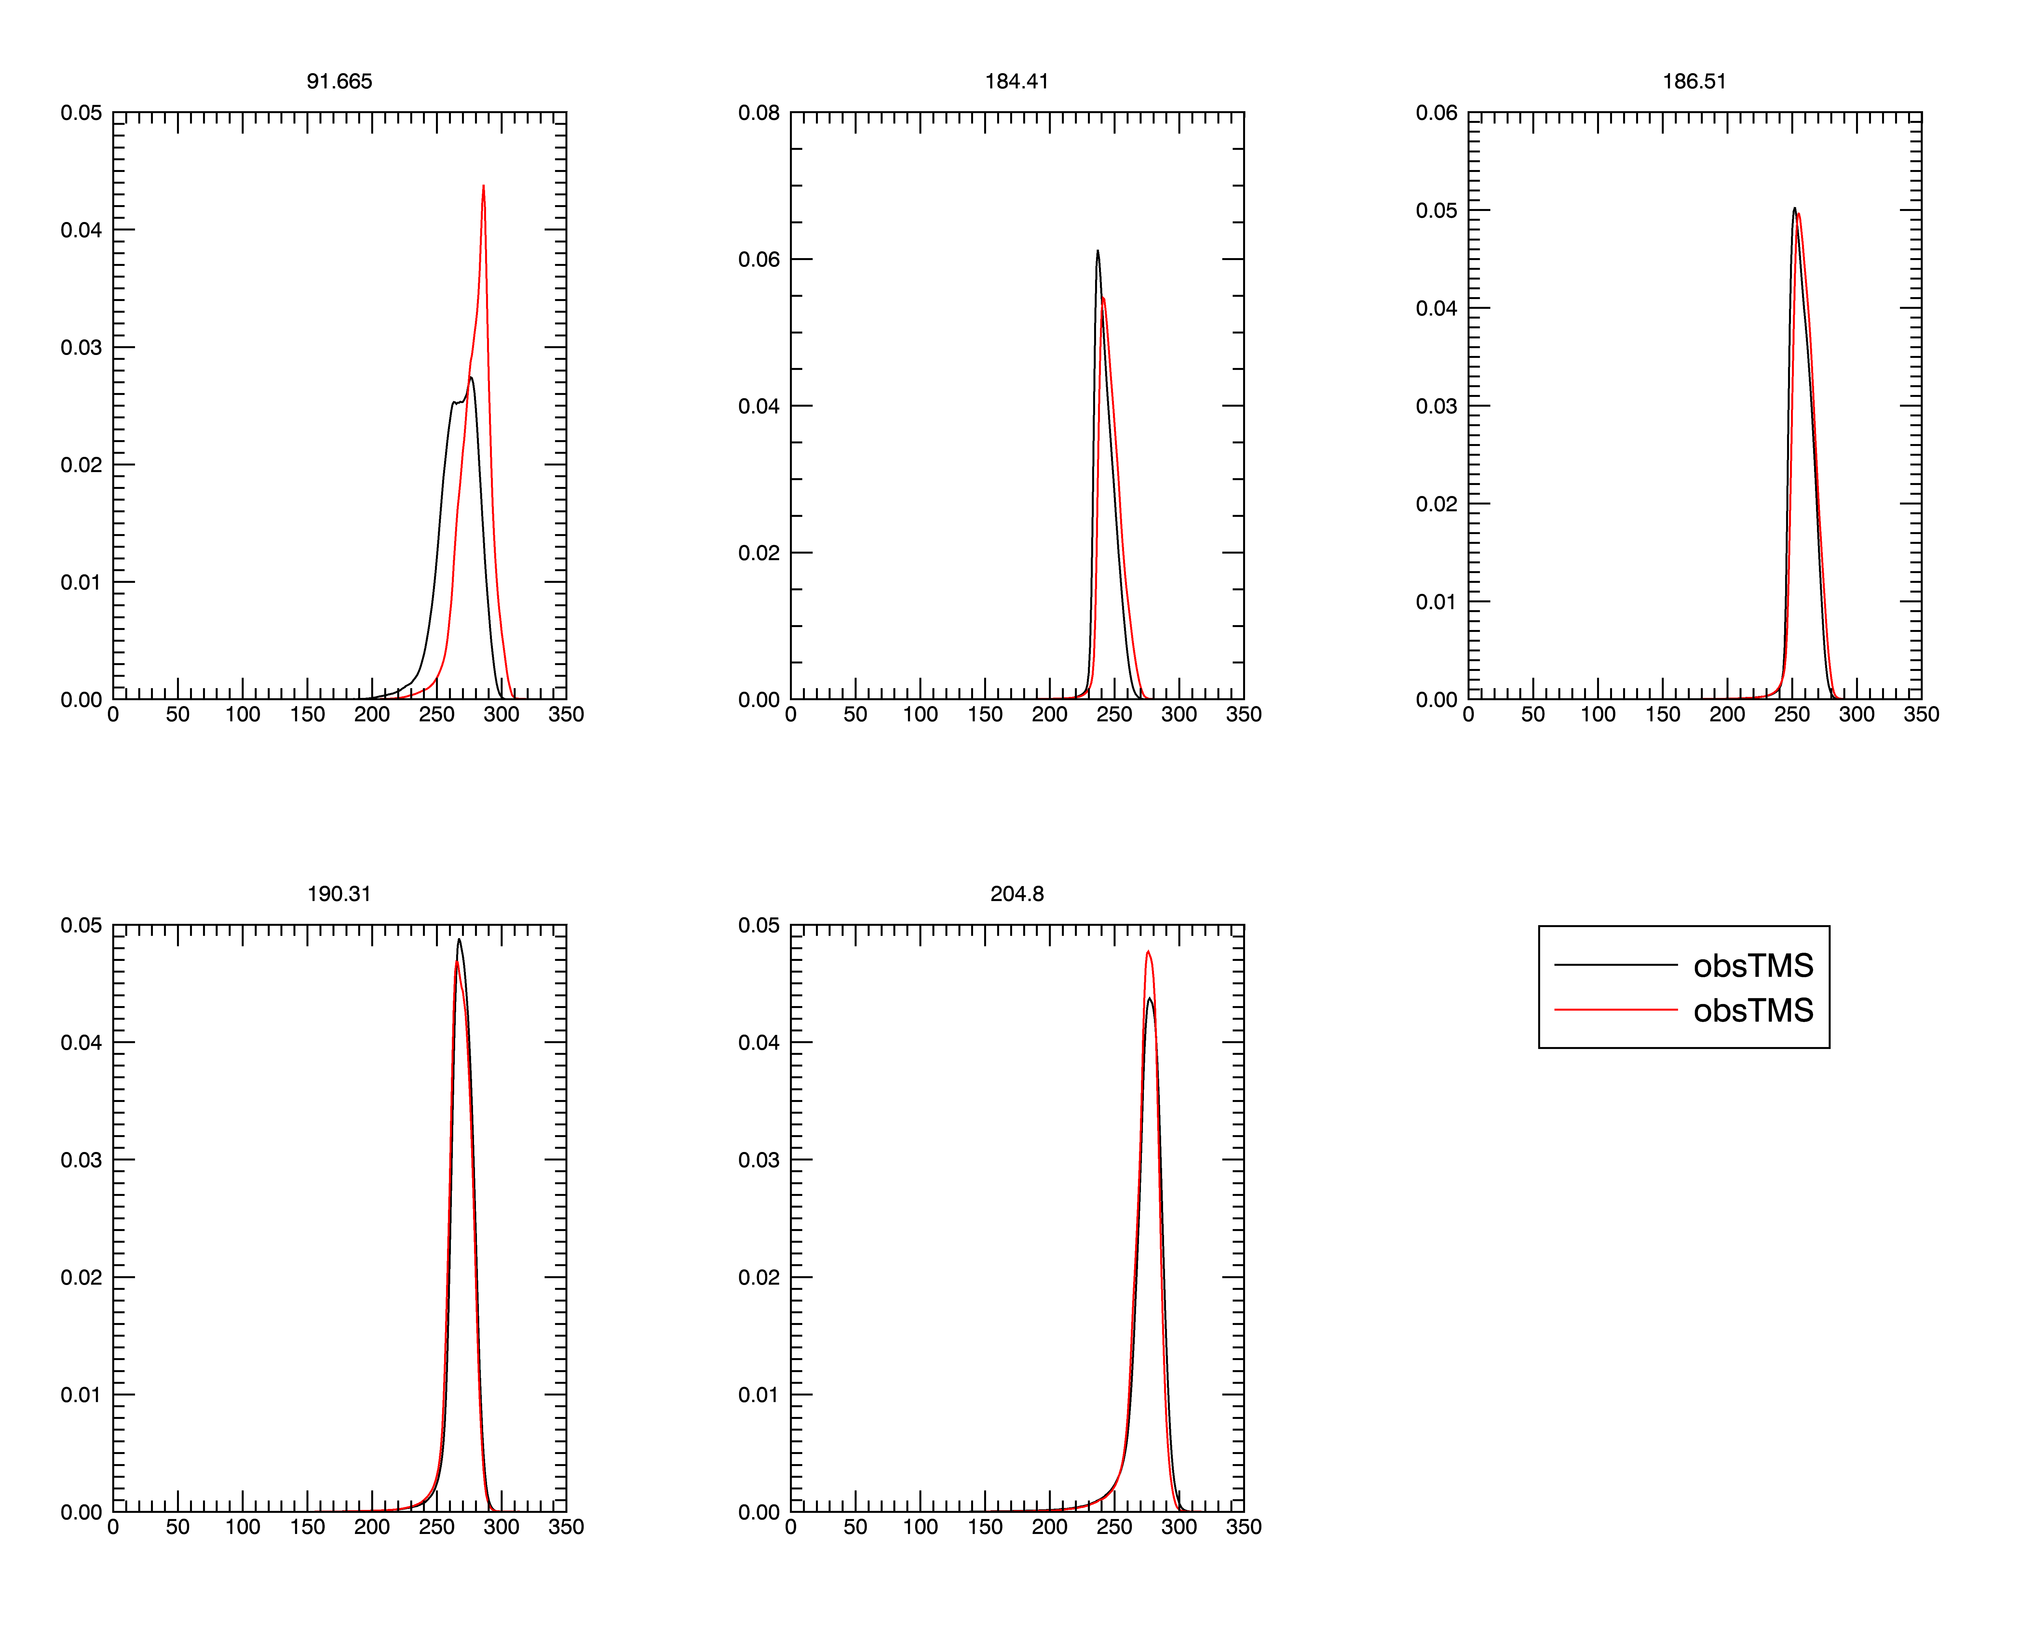
PDFs of TMS Pathfinder Observed vs Simulated Brightness temperature: Land
Nadir
53°
Tb (°K)
Tb (°K)

Slide 8
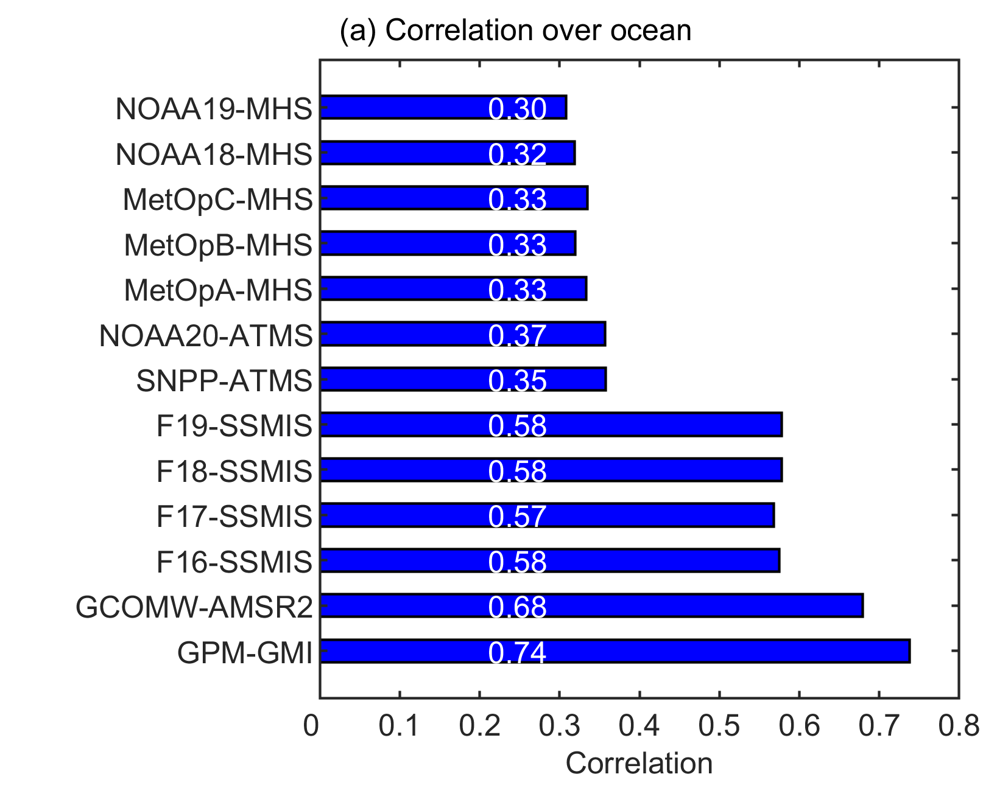
GPROF runs operationally in 3 versions
(differences due to ancillary data source)
All sensor data 1s from GPM Level 1C with extensive QC and intercalibration activity
Correlations (sensor & KuPR), over Ocean
Real time, 5 min. granules: GANAL Forecast. Not archived
Standard product: max 1 day latency: GANAL analysis
Climatology: longer latency. Waits for ERA5

Slide 9
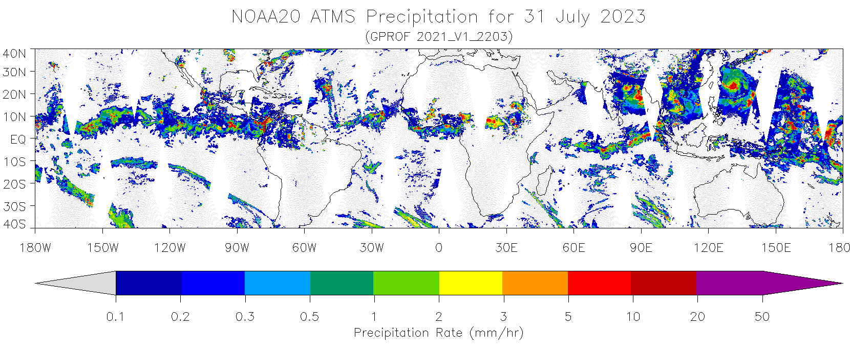
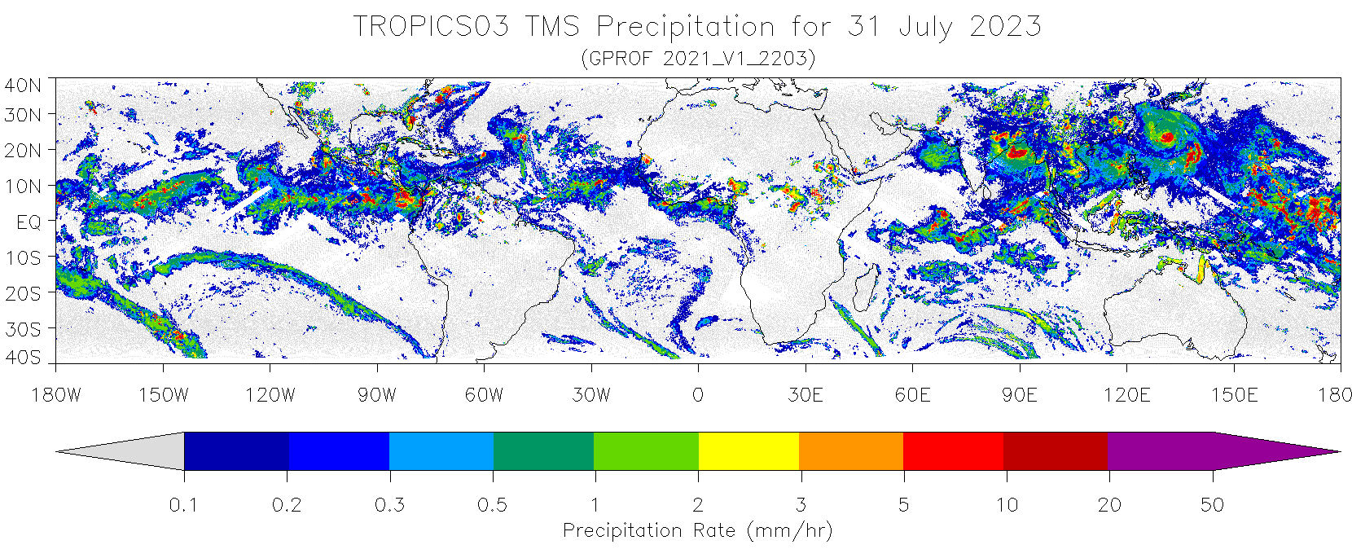

Slide 10
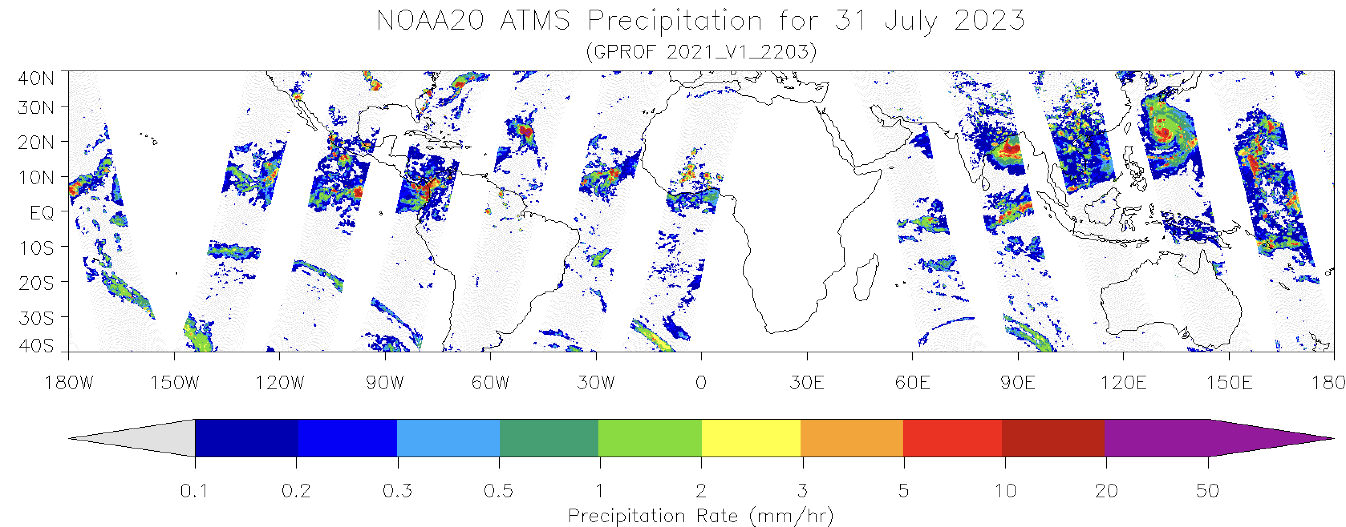
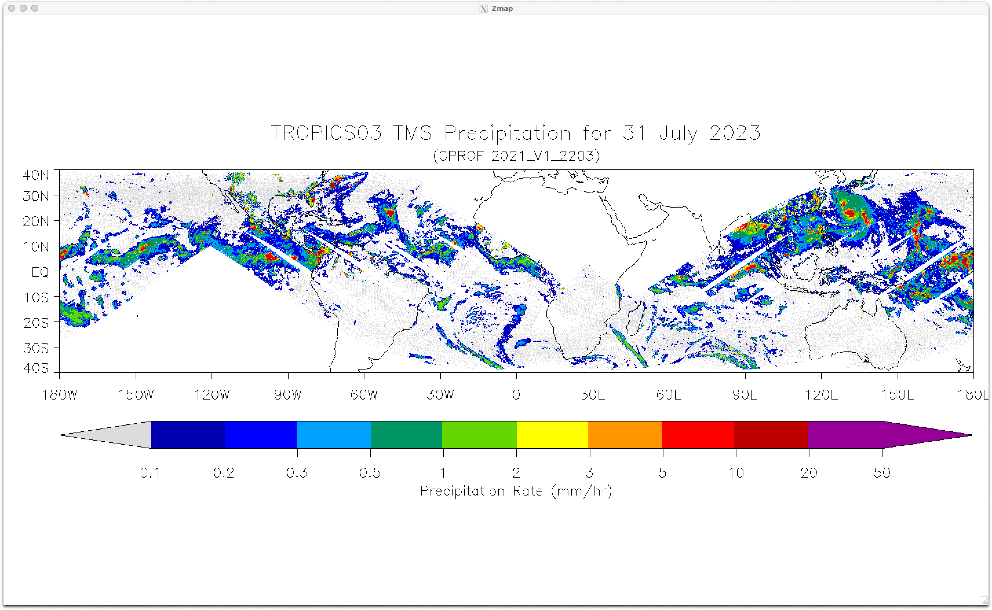

Slide 11
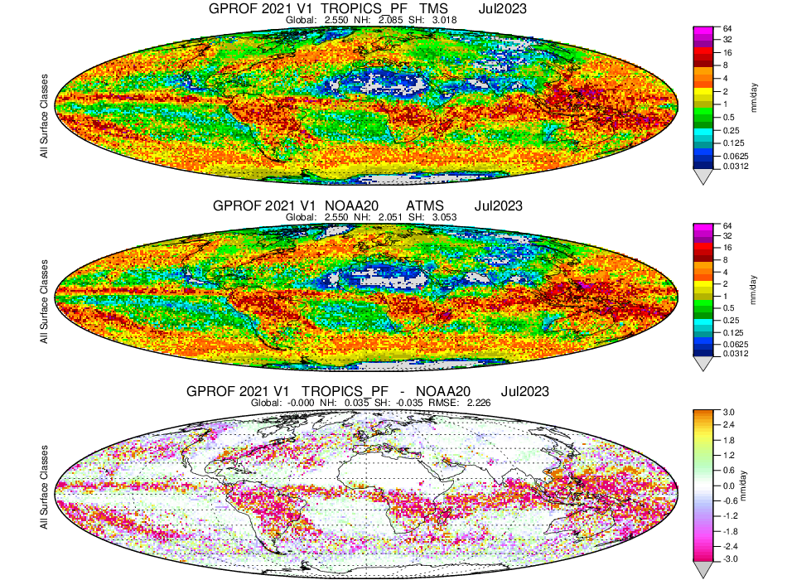
TROPICS Pathfinder and NOAA 20
Jan2023
Jan2023

Slide 12
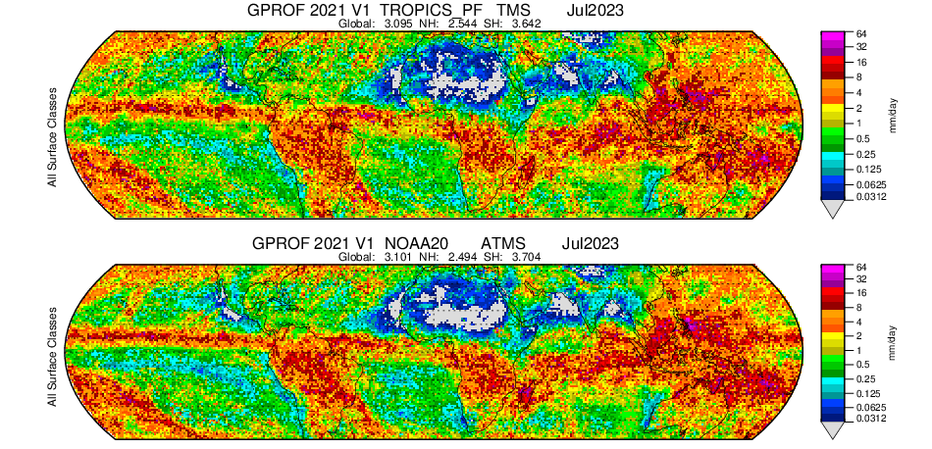
TROPICS Pathfinder and NOAA 20
Jan2023
Jan2023

Slide 13
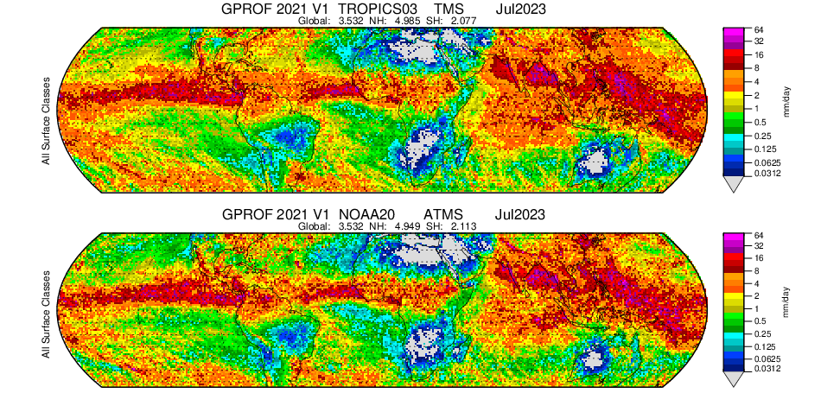
TROPICS 03 and NOAA 20

Slide 14
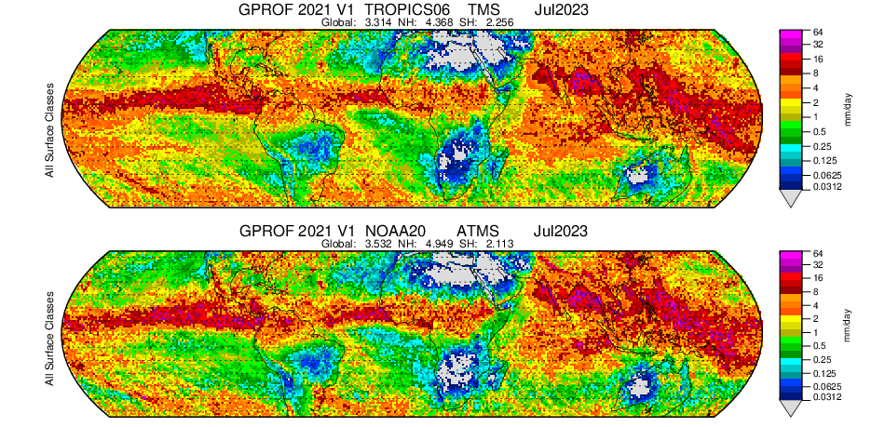
TROPICS 06 and NOAA 20

Slide 15
QC is a problem
GPROF does not do QC beyond applying L1C file QC flags
Machine learning methods being developed to identify bad data
Jackson Tan has a QC procedure developed for IMERG
University of Texas El Paso group also looking at QC for GPROF

Slide 16
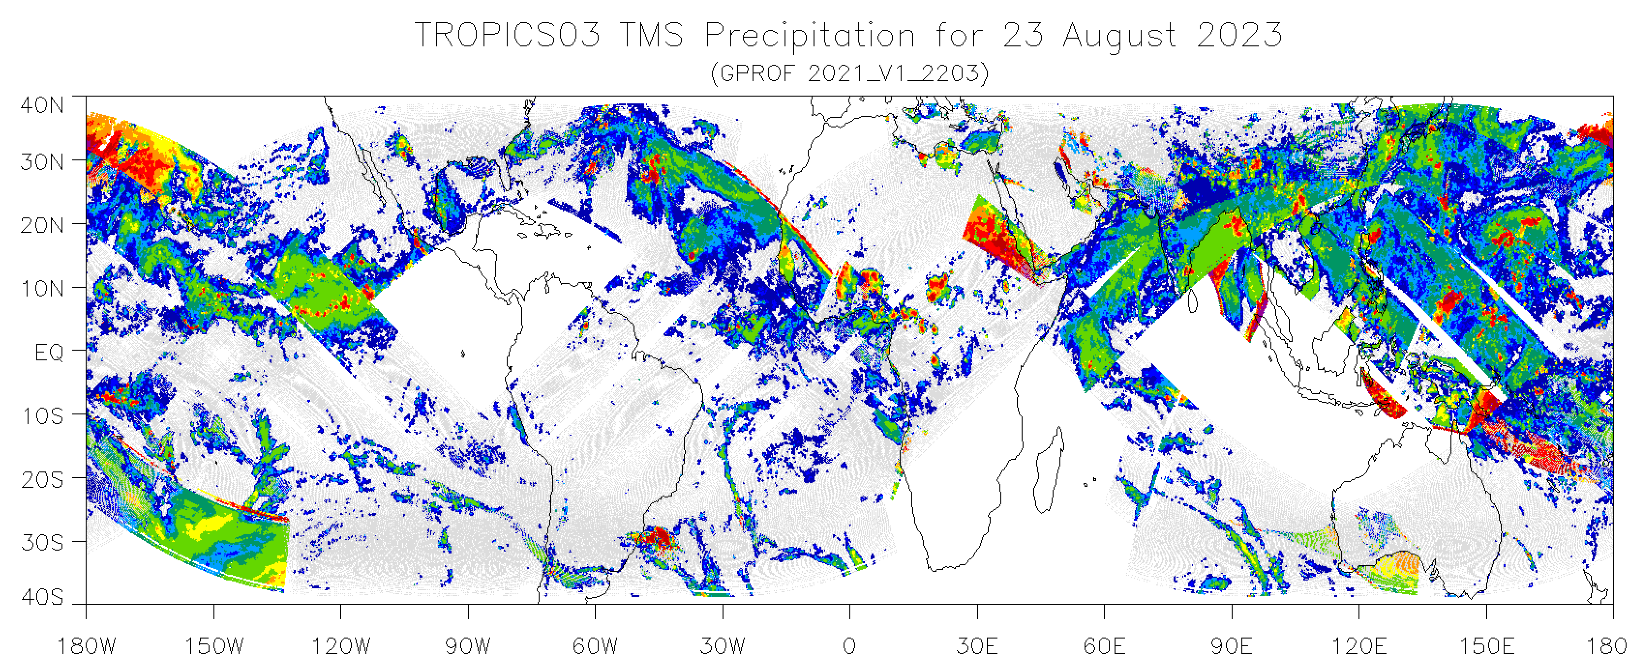
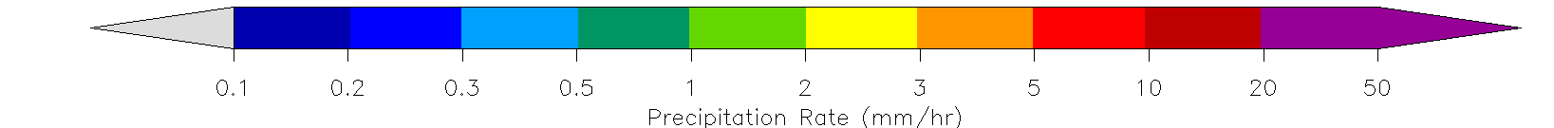

Slide 17
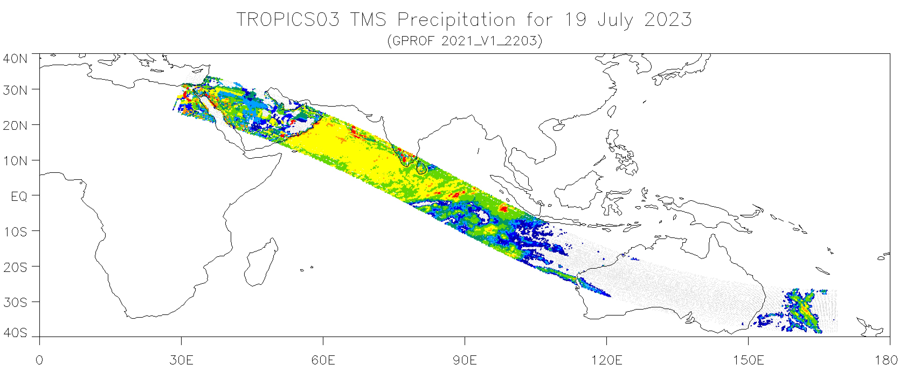

Slide 18
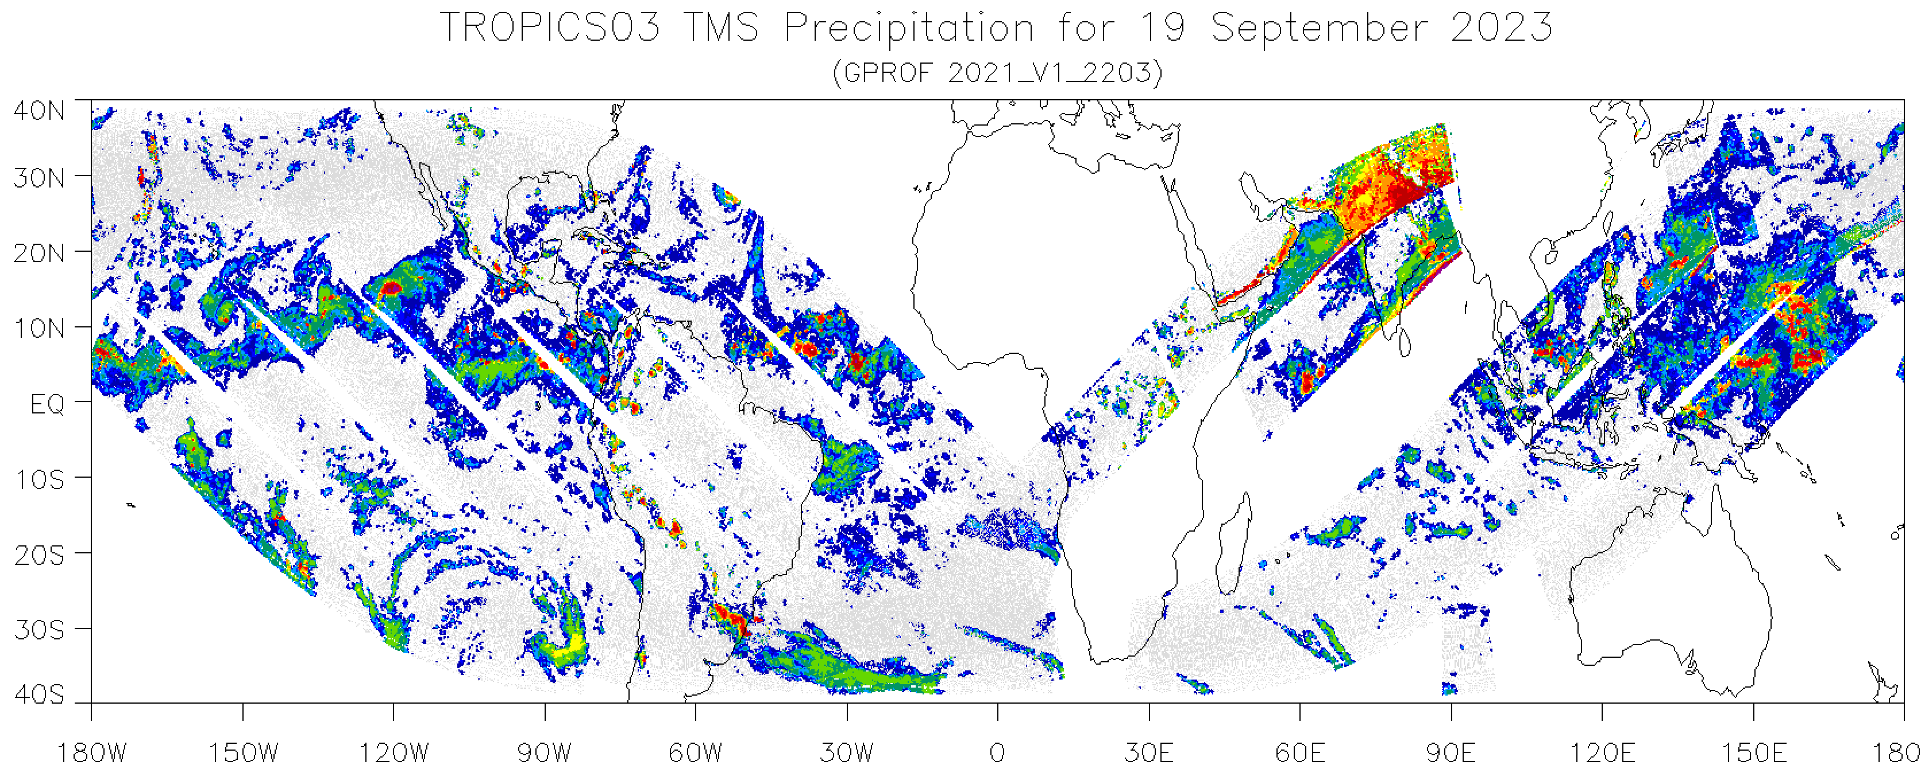
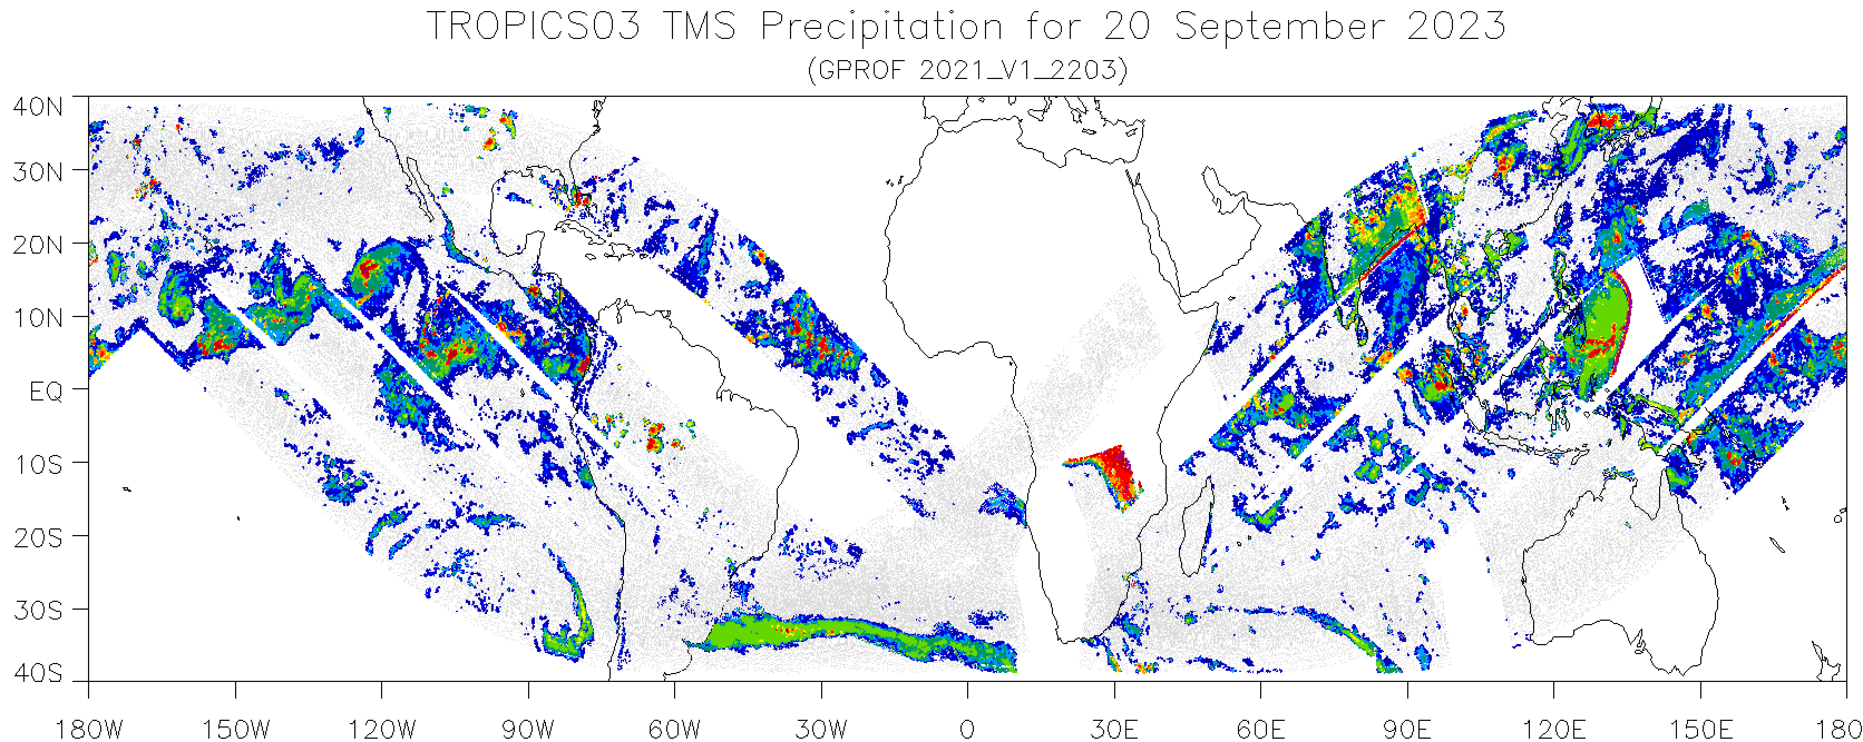

Slide 19
Issues with operational usage
• Precipitation looks very consistent with ATMS and should have positive impact on integrated precipitation products
• QC of input data not currently good enough for IMERG. GPROF does not have a robust QC process because it was always done at the Level 1 activity. We are developing that now, but slow progress (TROPICS is not a funded activity).
• Data systems are reluctant to open up gates for new sensors that have little vetting and may not last very long. Have workaround idea for very quick adoption of new sensors.

Slide 20
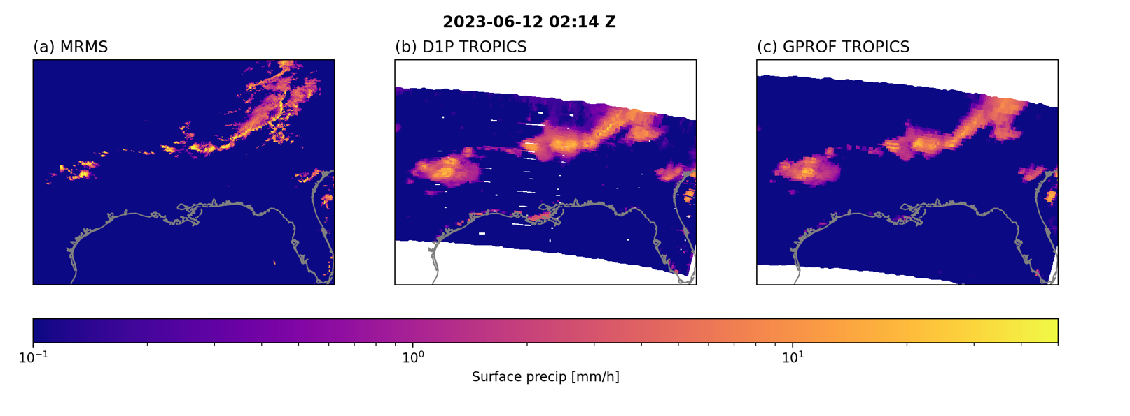
Turning TROPICS into ATMS
for Precipitation Retrievals
Ground radar
TROPICS Tb in ATMS format and ATMS rain algorithm
Customized TROPICS rain algorithm

